Slide 1
Jamboree On the Air
(JOTA)

Slide 2
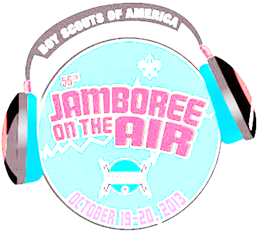
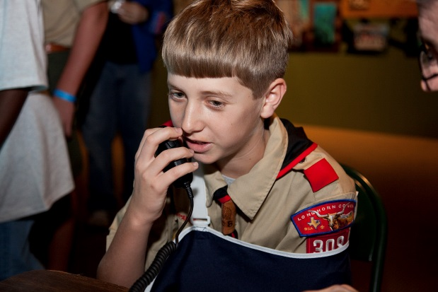
What is JOTA?
JOTA is an annual event in which Boy and Girl Scouts and Guides
from all over the world
speak to each other by means of Amateur (ham) Radio
A World Jamboree
Started in 1958
Over a half a million Scouts and Guides participate annually
A way to exchange Scouting experiences.
A way to make friends in other countries without leaving home
No age or number of participant restrictions
Little or no expense
**** The radio stations are operated by licensed amateur radio operators ****
Notes:
When Scouts want to meet young people from another country, they usually think of attending a
World Jamboree.
But few people realize that each year more than half a million Scouts and Guides "get together"
over the airwaves for the annual Jamboree-on-the-Air (JOTA).
The World Scout Bureau reported that the 2010 JOTA had just over 700,000 Scout participants
from nearly 6,000 amateur radio stations!
Modern technology offers Scouts the exciting opportunity to make friends in other countries
without leaving home.
JOTA is an annual event in which Boy and Girl Scouts and Guides from all over the world speak
to each other by means of Amateur (ham) Radio.
Scouting experiences are exchanged and ideas are shared via radio waves.
Since 1958 when the first Jamboree-on-the-Air was held, millions of Scouts have met each other
through this event.
Many contacts made during JOTA have resulted in pen pals and links between Scout troops
that have lasted many years. With no restrictions on age or on the number of participants,
and at little or no expense, JOTA allows Scouts to contact each other by ham radio.
The radio stations are operated by licensed amateur radio operators.
Many Scouts and leaders hold licenses and have their own stations, but the majority participate in
JOTA through stations operated by local radio clubs and individual radio amateurs.
Some operators use television or computer-linked communications.

Slide 3
When is JOTA?
Jamboree-on-the-Air is held the third weekend in October
The official hours
Start Saturday at 00:00 hours local time (right at midnight Friday)
End Sunday 24:00 (midnight Sunday evening)
“JOTA Jump Start”
Friday from 18:00 to 23:59 local time test your setup

Slide 4
How costly is JOTA?
It is a World Jamboree that requires little or no travel
Maybe travel to neighborhood radio amateur’s ham shack
Amateur Radio operators will come to you
at a Scout camporee
at your council’s camp
at the council’s office

Slide 5
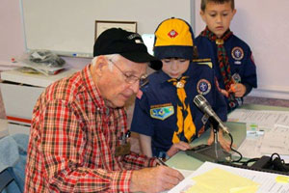
Who?
Local amateur radio clubs
Pikes Peak Radio Amateur Association (PPRAA)
Garden of the Gods Amateur Radio Club (GGARC)
Cheyenne Mountain Repeater Group (CMRG)
Scouts of any age can participate
Cub Scouts
Boy Scouts
Venturers

Slide 6
What can we do with JOTA?
Meet other scouts nationally or world wide:
Voice - speaking into a microphone and listening on the station speakers
Texting - digital communication
ATV – Amateur Radio TV with slow scan to send still pictures, or fast scan like a TV
Morse Code – The “original digital mode” – learn before JOTA though!!!
AMSAT – Amateur Radio Satellite as well as the International Space Station (ISS)
The exchange include such information as:
name
location (called QTH in ham speak)
Scout rank and age
hobbies
The stations you’ll be communicating with can be other Scouts across town,
across the country, or even around the world!
2012 JOTA had nearly 700,000 Scout participants and 13,500 amateur radio stations!

Slide 7
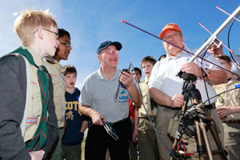
Local JOTA Activities?
Possible local activities:
Repeaters – Use local amateur radio repeaters to communicate locally or even world wide
GeoFoxing – a local fun activity combining Geocaching and transmitter (fox) hunt
Construction – Build and use your scout unit’s antenna
Signaling – Based on the special centennial merit badge
A participant patch is available (Ordered at http://www.scouting.org/jota/)
A certificate/log sheet is available - fulfill a Radio merit badge requirement.

Slide 8
Licensing Regulations for Amateur Radio Operators
As a licensed amateur radio operator, you must:
comply with FCC regulations (of course) regarding
Frequencies
Power
quality of signal
etc.
Third-party traffic is approved by the FCC.
U.S. Scouts can talk with other Scouts when both stations are licensed by the FCC.
When the station you are in contact with is outside U.S. jurisdiction,
a third-party agreement must exist between the U.S. and that country
If an agreement exists, then U.S. Scouts may talk directly to Scouts in that country.
If not, then the licensed ham radio operator must talk for the Scouts.

Slide 9
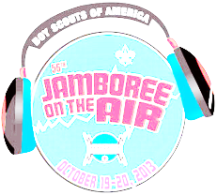
HF (worldwide) voice (SSB) frequencies
Band (Meter) | Calling Freq. 1 | Calling Freq. 2 | Operating Frequencies | Comments
80 | 3.940 | 3.690 | 3.920-3.940 | 3.670-3.690 (Extra Class)
40 | 7.190 |  | 7.180-7.200 7.270-7.290
20 | 14.290 |  | 14.270-14.290 14.320-14.320
17 | 18.140 |  | 18.140-18.150
15 | 21.360 |  | 21.360-21.400
12 | 24.960 |  | 24.960-24.980
10 | 28.390 |  | 28.350-28.400 | Tech – beginning license available
6 | 50.160 |  | 50.160-50.200 | Tech – beginning license available

Slide 10
HF (worldwide) CW (Morse Code) frequencies
Band (Meters) | Calling Frequency | Operating Frequencies | Comments
80 | 3.570 | 3.560-3.570 | Tech and above
40 | 7.030 | 7.030-7.040 | Tech and above
20 | 14.060 | 7.030-7.040 | General or above
17 | 18.080 | 18.070-18.080 | General or above
15 | 21.140 | 21.130-21.140 | Tech and above
12 | 24.910 | 24.900-24.910 | General or above
10 | 28.180 | 28.170-28.180 | Tech and above
6 | 50.160 | 50.150-50.160 | Tech and above

Slide 11
HF (worldwide) PSK (“Texting”) frequencies
Band (Meters) | Calling Freq | Alternate Frequencies | Comments
80 | 3.580
40 | 7.080 | 7.040 throuth 7.060
30 | 10.142
20 | 14.070 |  | Most activity for JOTA
17 | 18.100
15 | 21.080 | 21.070 | More activity at 21.070
12 | 24.920
10 | 28.120

Slide 12
Guideline for Scout Leaders (1 of 3)
Guidelines to follow as you prepare for the event:
Contact with local radio amateurs
well in advance
discuss a balanced program of activities
before and during JOTA
Make sure the amateur’s efforts are appreciated
ensuring that Scouts turn up for the event
build up the event through publicity within your council, district, and unit
JOTA is a Scout event, and as such
Scout leaders are in charge of the scouts
Keep firm control over those attending

Slide 13
Guideline for Scout Leaders (2 of 3)
Don’t assume that all radio amateurs are expert communicators with youth
Integrating events around JOTA can be very helpful in maximizing attendance.
For example,
set up a JOTA station (or several) at a camporee
Fox Hunting (transmitter hunting) or GeoFoxing
Antenna building
Emergency Service, First Aid, Signaling, Radio Merit badge…etc.
Order participant patches for the number you expect to attend.
Include some patches to share with the radio amateurs.
Download the certificate of participation and log sheet. Duplicate enough for all participants.

Slide 14
Guideline for Scout Leaders (3 or 3)
Review the section titled “Amateur Radio Terms”
Feed the radio amateurs on the day of the event
Thank the radio amateurs for their assistance
Register your event beforehand to the national JOTA organizer at jota@scouting.org
send an email including
location and a description of activities
the station call sign
expected number of participants
Check the scouting.org/jota site often for updates
Schedule contacts
File a report of your station’s activities
Use the format at “JOTA Event Report Form.”
a summary will be included in the full U.S. report to the World Scout Bureau.

Slide 15
General Guidelines for Radio Operators (1 of 4)
Jamboree-on-the Air is about getting young people to talk to each other using amateur radio.
Arrange for the use of a club call sign, or apply for a special-event call sign in plenty of time.
Prepare some simple diagrams and explanations
showing how radio works
how signals can be transmitted around the world as well as to the nearest repeater.
Arrange with the Scout leaders
regarding venue QSL cards
patches participation certificates
other activities physical arrangements
publicity details required for the JOTA report form

Slide 16
General Guidelines for Radio Operators (2 of 4)
Notify national JOTA organizer
use details on the registration form
Go to Scout meetings beforehand to introduce the subject
Organize activities
kit building soldering practice
SSTV FSTV
packet radio weather satellite reception
Simplest of things, such as a closed-circuit RTTY station, can generate a great deal of excitement.
Offer to assist Scouts with the Radio merit badge.

Slide 17
General Guidelines for Radio Operators (3 of 4)
Offer a Technician license preparation
Ensure that no more than three Scouts are watching one Scout on the air (best practice)
Keep Scouts involved and active or they will quickly grow bored.
Ensure that the station is safe for young visitors.
Observe your license conditions, especially regarding third-party traffic.
Involve the Scouts in the contact.
The goal is to involve as many Scouts as possible in making a contact.
It is not to maximize the number of contacts or the distance of the contacts;
it's about the experience for the Scouts.

Slide 18
General Guidelines for Radio Operators (4 of 4)
Try to use plain, understandable English where possible.
When you do use Q-signals and other ham radio terms, take time to explain them
Don't try to work weak stations from remote locations.
Go for stronger, more local stations
Work stations unpracticed ears can hear easily understand.
Local FM repeaters can be just as exciting for Scouts.
Don't feel you have to keep the station on the air with no Scouts present.

Slide 19
Reference: Useful Internet Sites
K2BSA Amateur Radio Association
http://www.k2bsa.net
BSA JOTA Information (Guidelines, Planning, Registration, Resources, Reports)
http://www.scouting.org/jota.aspx
Registration: http://www.scouting.org/jota/station_registration.aspx
List of Registered: http://www.scouting.org/jota /registered_stations.aspx
World Organization of the Scout Movement JOTA Information
http://scout.org/en/information_events/events/jota
ARRL JOTA Information
http://www.arrl.org/jamboree-on-the-air-jota
Ultimate resources site for everything ham radio
http://www.ac6v.com/

Slide 20
Reference: Internet Discussion Groups
Best all-around Radio Scouting discussion group
http://groups.yahoo.com/group/ScoutRadio/
Worldwide coverage; however, be certain to post identical information at ScoutRadio at Yahoo
http://groups.yahoo.com/group/JOTAskedbook
Discussions, announcements, and promoting getting "Scout Camps on the Air (SCOTA)"
http://groups.yahoo.com/group/scoutcamps_ota/

Slide 21
Resources: Loaners and PPRAA
Pikes Peak Radio Amateur Association (PPRAA) – Request JOTA help/operation
Local amateur radio club with over 75 years in existence
Email to: Boardmembers@ppraa.org
Station Loans – Icom America
Icom America and the Boy Scouts of America have entered into a sponsorship agreement.
One aspect of that agreement is that Icom America will provide up to 10 complete amateur
radio stations for use by local Scout councils beginning in 2012 and extending through 2015.
Stations can be requested for long-term development loan stations and for event loan
stations. You can find the details, application, and loan agreement here:
http://www.scouting.org/filestore/jota/pdf/AmateurRadioStationLoanProgram.pdf

Slide 22
Credits
All slides derived from JOTA web sites:
http://www.scouting.org/jota/operator_guides.aspx
http://www.k2bsa.net/
Presenters:
Gordon Dixon Callsign W0RGD
Dan Scott Callsign W0RO

Slide 23
Questions?

Slide 24
Appendix A: Common Terms
ATV | Amateur television. Sometimes called Fast Scan TV. Same as commercial TV.
CQ Jamboree or CQ JOTA | A request for any other JOTA station to answer my call.
CW | A mode for sending messages by Morse Code.
FM | Frequency modulation
Ham | Slang for amateur radio operator.
Logging | To record details of the contacts made for future reference. The log includes call signs, time, frequency, names, etc.
Net | A group of stations who meet “on the air” at a specified time for a specific purpose.
Packet | A digital form of communications as in teletype but more reliable. Requires a computer, an interface box, and a radio transceiver.
QSL Card | A written acknowledgment that a contact has been made by amateur radio between the two parties. QSL cards are usually of the postcard variety.
RTTY | Radio teletype.
Schedule | A prearranged meeting "on the air" at a preset time and frequency.
Shack | The room where the amateur operator has his radio.
SSB | Single side band. A form of voice communications.
SSTV | Slow Scan TV. A single frame shown like a still picture. Example: WX photo from satellite.
TNC | Terminal node controller. The interface in packet between the computer and the transceiver.
Transceiver | A transmitter and receiver in a single box.
XYL | Wife
YL | Young lady (girlfriend)
73 | Best wishes
88 | Love and kisses

Slide 25
Appendix B: Q Codes
The "Q" Code was originally developed as a way of sending shorthand messages in Morse Code. However, it is still used by operators for voice communications. Some of those in common use are listed below.
QRA What is your call sign.
QRM I have interference (manmade).
QRN I am receiving static (atmospheric noise).
QRT I am closing station.
QRX Please wait.
QRZ Who is calling me?
QSB Your signal is fading.
QSL I acknowledge your contact.
QSO Are you in contact with__________?
QSY Change frequency to__________.
QTH My location is__________.

Slide 26
Appendix C: Phonetic Alphabet
A - Alpha
B - Bravo
C - Charlie
D - Delta
E - Echo
F - Foxtrot
G - Golf
H - Hotel
I - India
J - Juliet
K - Kilo
L - Lima
M - Mike
N - November
O - Oscar
P - Papa
Q - Quebec
R - Romeo
S - Sierra
T - Tango
U - Uniform
V - Victor
W - Whiskey
X - X‑Ray
Y - Yankee
Z - Zulu

